Slide 1
Trip Data Analysis
Converting Casual Riders to Annual Members

Slide 2
Business Task
Identify how casual riders and annual members use the bike-share system differently to help the marketing team design strategies that convert more casual riders into members.

Slide 3
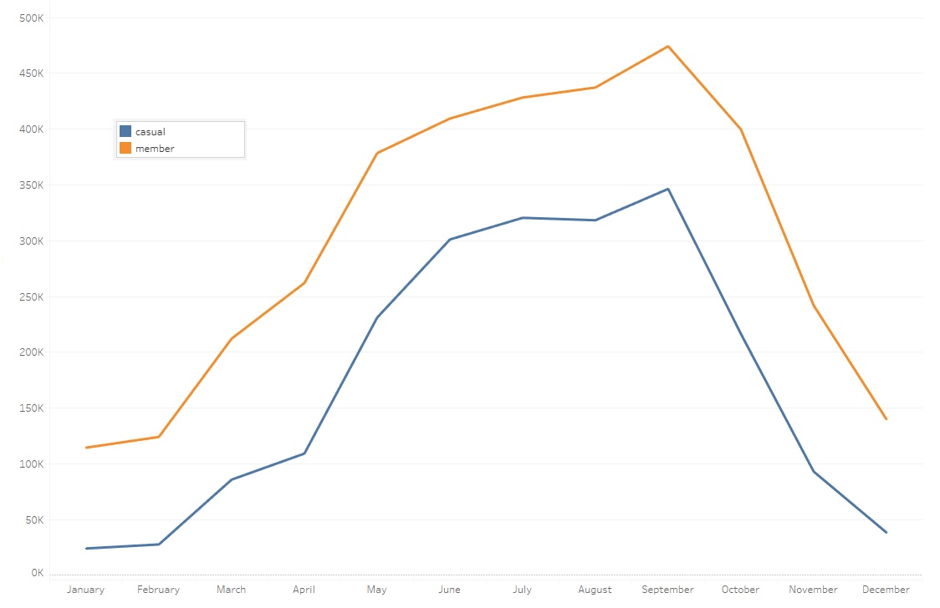
Analysis Summary
The number of trips taken by both members and casual riders gradually increases from January and reaches a peak in September.
The graph clearly shows a huge drop in the number of trips made during the winter.

Slide 4
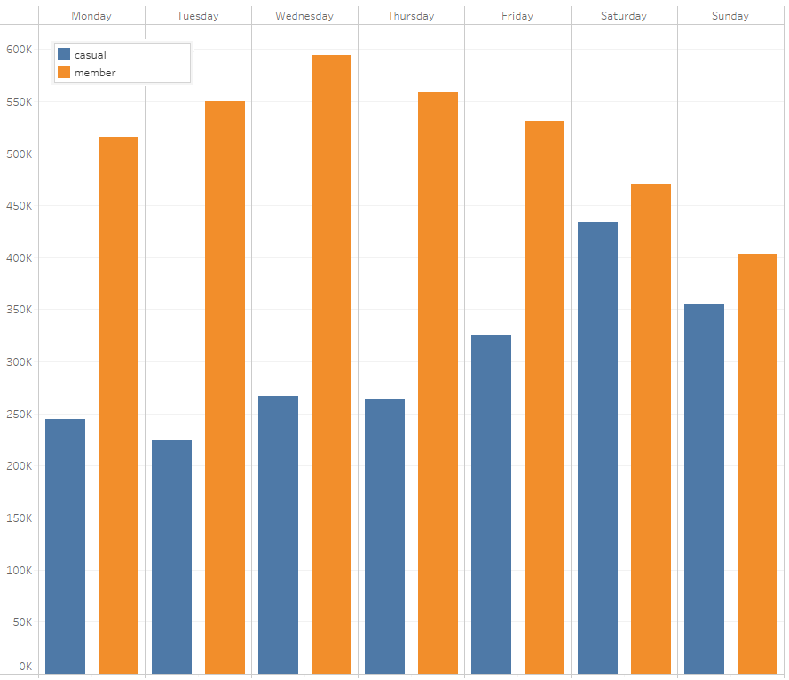
Analysis Summary
Members tend to ride more during the weekdays, while casual riders are considerably more active on weekends.
This pattern suggests that members may be using bikes primarily for their daily commutes while casual riders are more likely to use the service for leisure

Slide 5
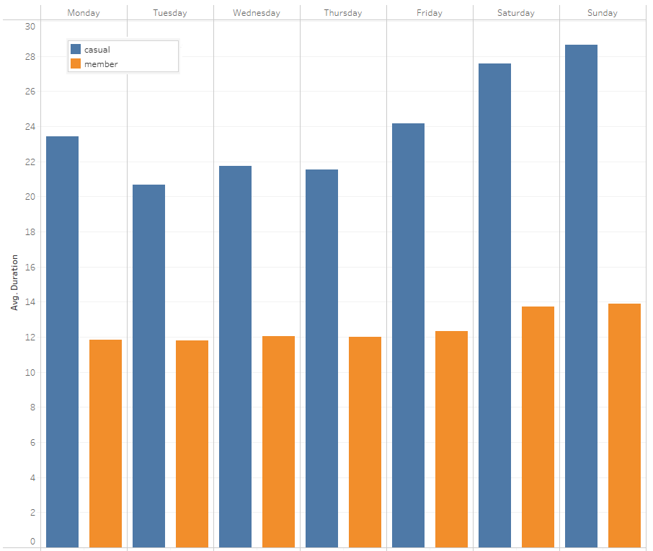
Analysis Summary
This graph shows average trip duration by day of the week
Additionally, casual riders not only use bikes more on weekends but also take significantly longer rides — about 1.7 times the duration of members on average.

Slide 6
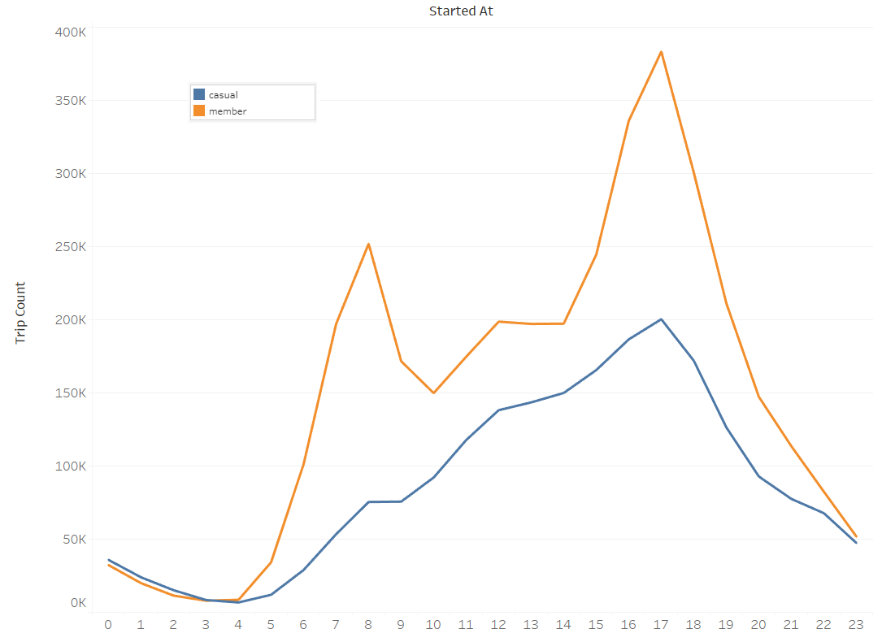
Analysis Summary
Here we can see the number of trips by hour. There is a clear peak at 8 a.m. for members.
This further supports the observation that members predominantly use bikes for their daily activities — for example, commuting to work — while casual riders are more likely to use their rides as a chance to relax and enjoy themselves.

Slide 7
Recommendations
Riding Benefits
Remind casual riders all the benefits from riding on a daily basis, including:
• Physical Health Benefits
• Mental Health Benefits
• Environmental Benefits
• Financial Benefits
• Lifestyle Benefits

Slide 8
Recommendations
Gamification
Gamify the members experience by introducing features like riding streaks, personal goals, and leaderboards to encourage friendly competition among friends and family.

Slide 9
Recommendations
Financial Incentives
Use targeted messages like: “Riding more than twice a week? A membership pays for itself.”
Offer 1-week or 1-month trial memberships at a discounted rate for casual riders.

Slide 10
Thank you.

